Slide 1
Notes:
Welcome to the HashiCorp Terraform training course.

Slide 2

Your Name
Your Role, Your Company
Interesting Fact

Slide 3
Notes:
So let's get started with Terraform!

Slide 4
Chapter Goals
Introduction to Infrastructure as Code
Provision to Azure
Basic Blocks of Terraform
Fire It Up!
Quiz
Notes:
First we'll talk about Terraform and terminology
Then we'll take a step back and talk about the broader concept of "infrastructure as code"...

Slide 5
Introduction

Slide 6
What is Infranstructure as Code
Infrastructure as Code (IaC) is the process of managing and provisioning computer data centers through machine-readable definition files.
Notes:
Infrastructure as code is about extrapolating the definition of my machines and their requirements into a codified language that I can then use for testability, repeatability and scalability

Slide 7
Infrastructure as Code
Provide a codified workflow to create infrastructure
Expose a workflow for managing updates to existing infrastructure
Integrate with application code workflows (Git, SCM, Code Review)
Provide modular, sharable components for separation of concerns
Notes:
Before discussing Terraform, let's discuss the principles and goals of "Infrastructure as Code".
When discussing IaC, one of the primary goals is to provide a repeatable workflow for creating and managing infrastructure. This is especially important in the context of ephemeral staging environments or disaster recovery scenarios.
Arguably of equal importance is the ability to safely manage updates to existing infrastructure components.
IaC promises to bring the same tools and techniques of application development (SCM, code review, etc) to infrastructure management.
And lastly, IaC aims to expose ways to share components and separate responsibilities (modules).

Slide 8
Provisioning a Virtual Machine
Name
Operating System (Image)
Size
Location
Username and Password
Notes:
Infrastructure as code is about extrapolating the definition of my machines and their requirements into a codified language that I can then use for testability, repeatability and scalability

Slide 9
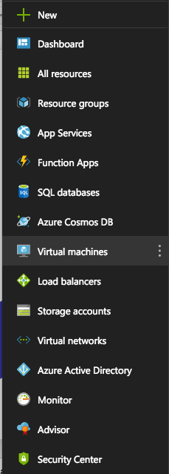
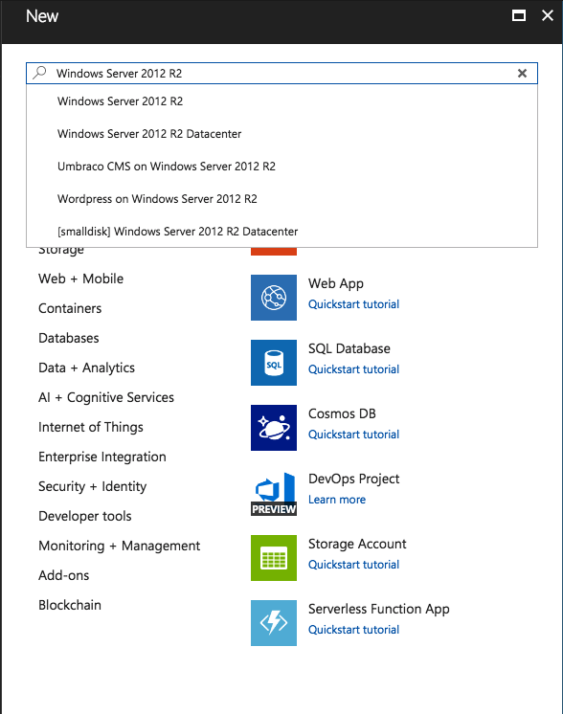

Slide 10
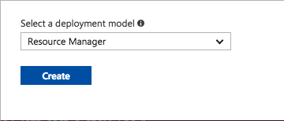

Slide 11
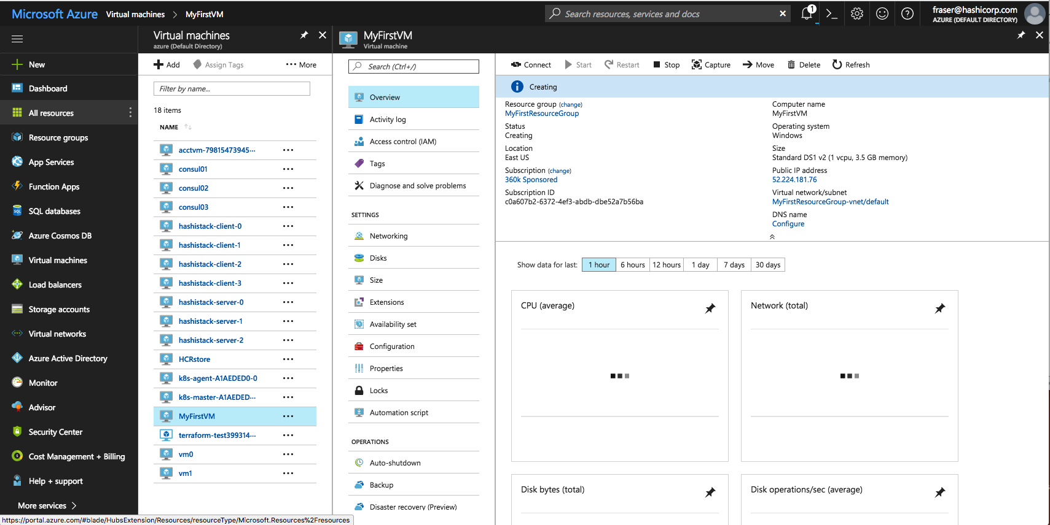

Slide 12
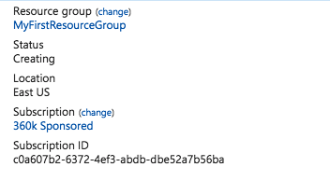

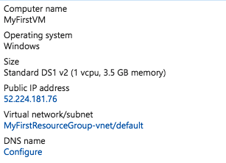
main.tf
resource ”azure_instance” “web” {
name = “MyFirstVM”
image = “Windows 2012 R2”
size = “Standard DS1”
location = “East US”
username = “John Doe”
password = “Iamrootfearme!”
}

Slide 13
main.tf
resource ”azure_instance” “web” {
name = “MyFirstVM”
image = “Windows 2012 R2”
size = “Standard DS1”
location = “East US”
username = “John Doe”
password = “Iamrootfearme!”
}

Slide 14
What is Terraform
Terraform is a tool for building, changing, and versioning infrastructure safely and efficiently.
Notes:
Infrastructure as code is about extrapolating the definition of my machines and their requirements into a codified language that I can then use for testability, repeatability and scalability

Slide 15
Terraform and Infrastructure as Code
Infrastructure is described using a high-level configuration syntax. This allows a blueprint of your datacenter to be versioned and treated as you would any other code. Additionally, infrastructure can be shared and re-used.
Notes:
Infrastructure as code is about extrapolating the definition of my machines and their requirements into a codified language that I can then use for testability, repeatability and scalability

Slide 16
Infrastructure as Code (Terraform)
Human-readable configuration (HCL) is designed for human consumption so users can quickly interpret and understand their infrastructure configuration.
HCL includes a full JSON parser for machine-generated configurations.
Notes:
How does Terraform respond to these requirements?
Terraform's configuration files are intentionally human readable so humans can quickly interpret and understand their infrastructure configuration.
But HCL is also fully JSON-compatible for machine-generated configurations.

Slide 17
main.tf
resource "aws_instance" "web" {
ami = "ami-9a562df2"
instance_type = "t2.micro"
}
Notes:
Here is an example of Terraform's configuration syntax. Even if you've never worked with Terraform before, it should be clear what operation is taking place here:
> Create an AWS instance with the given AMI ID and instance type.

